Slide 1
PRO_WEAR
Presented by :
Roopal, Eshita, Riya & Masudha

Slide 2

Why do we need PRO_WEAR ?
In today’s day and age when no gender is safe regardless of their age, instant help is what we need in case of any emergency situation like accident, robbery,kidnapping etc. Our product aims to notify an individual’s trust worthy contacts and a continuous live location sharing of the victim.

Slide 3
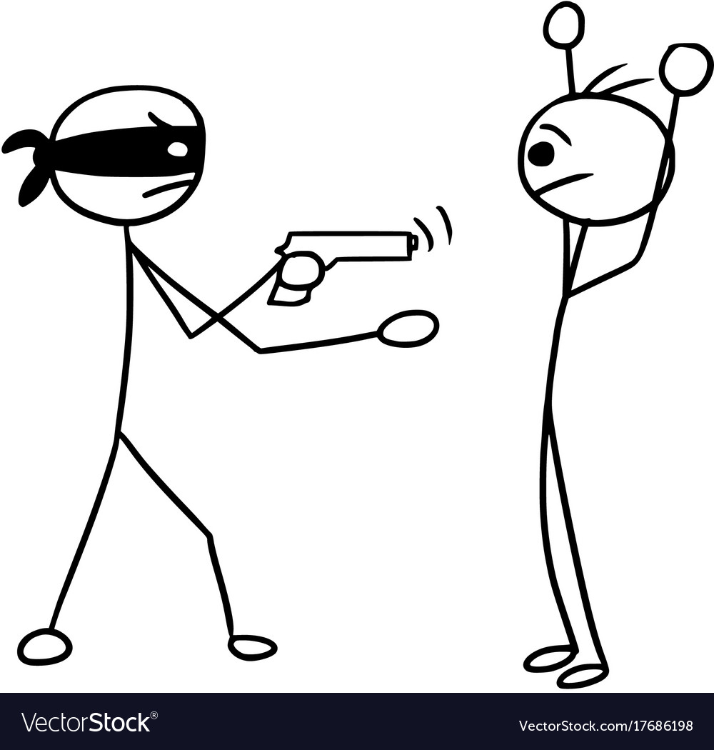
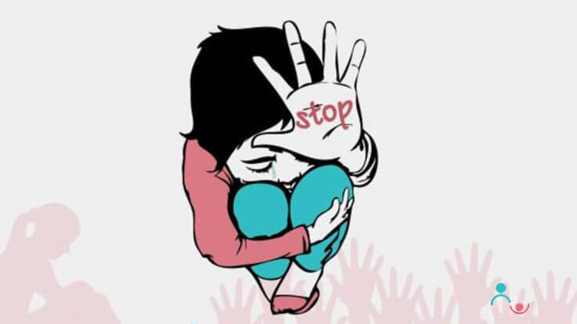
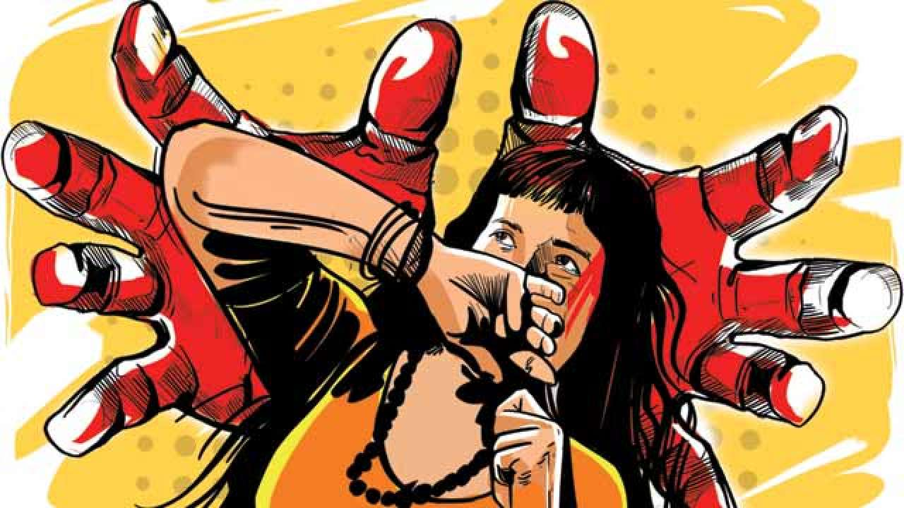
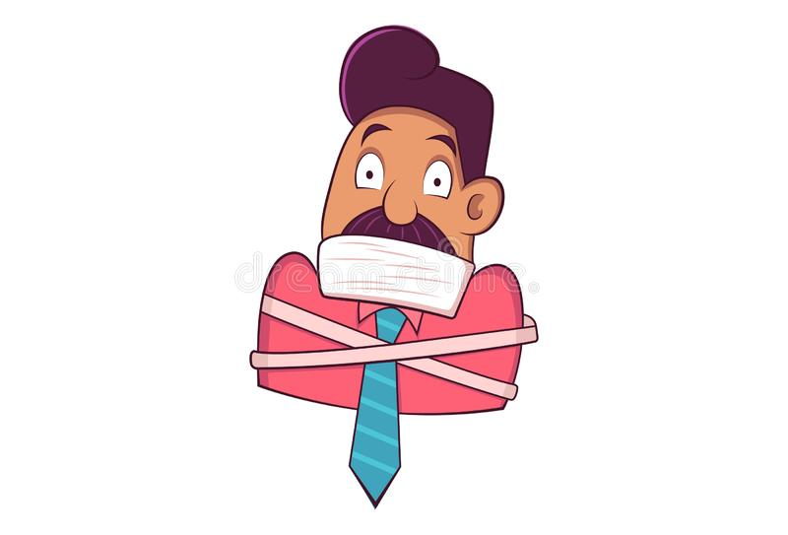


Slide 4


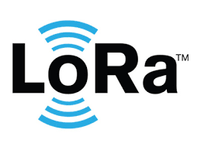
Hardware and technologies used

Slide 5
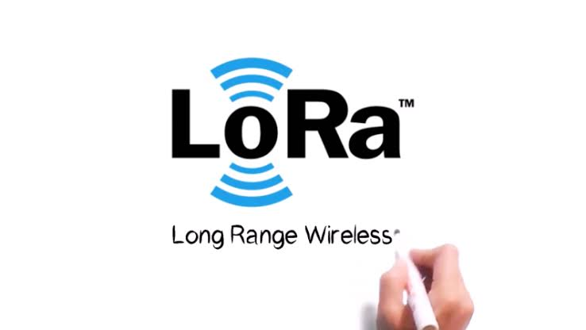
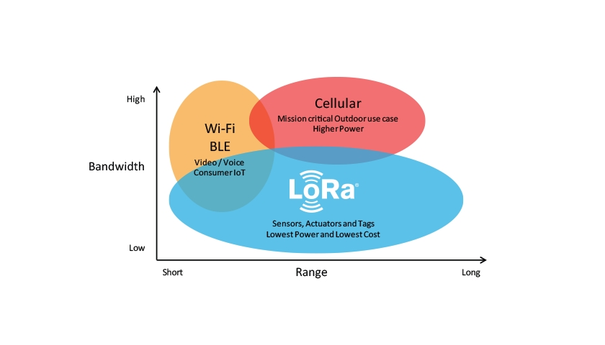
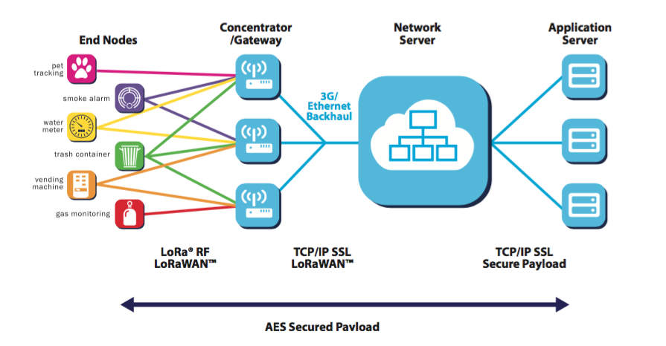
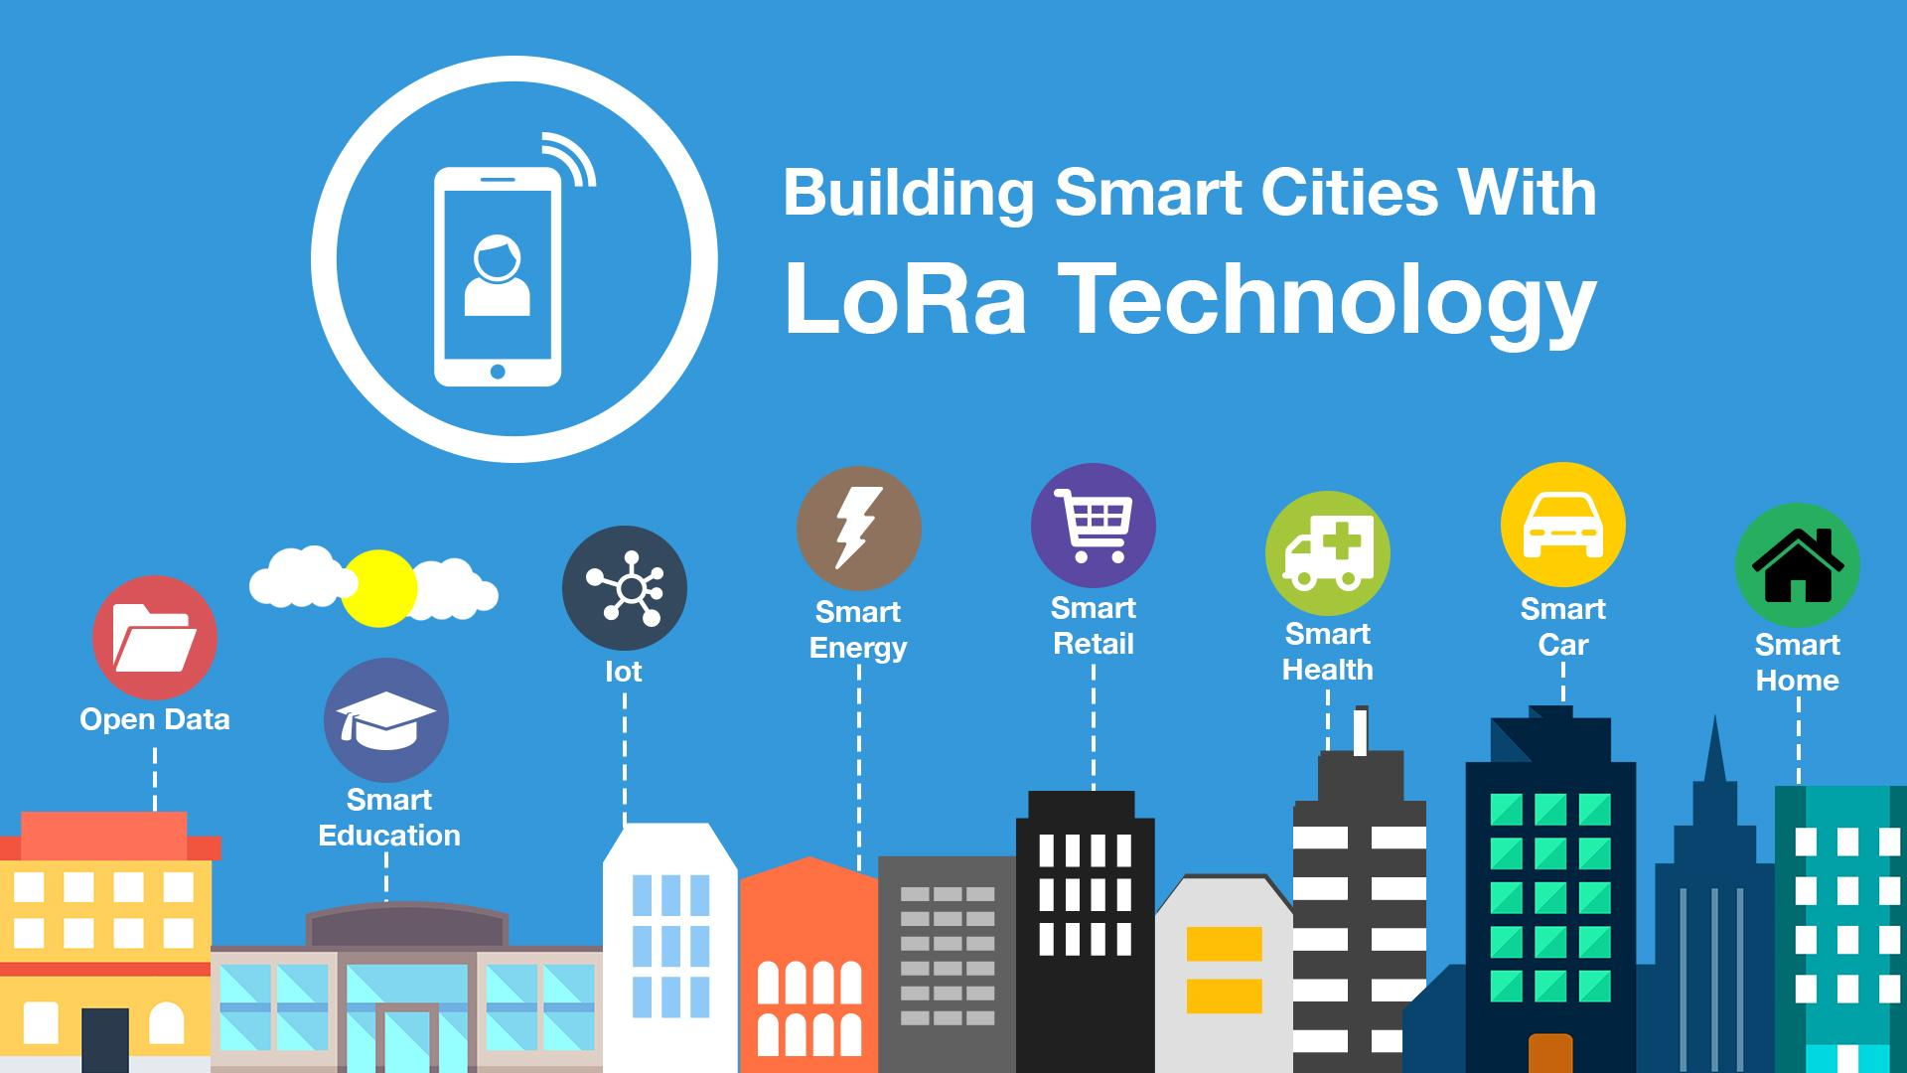
About LoRA

Slide 6
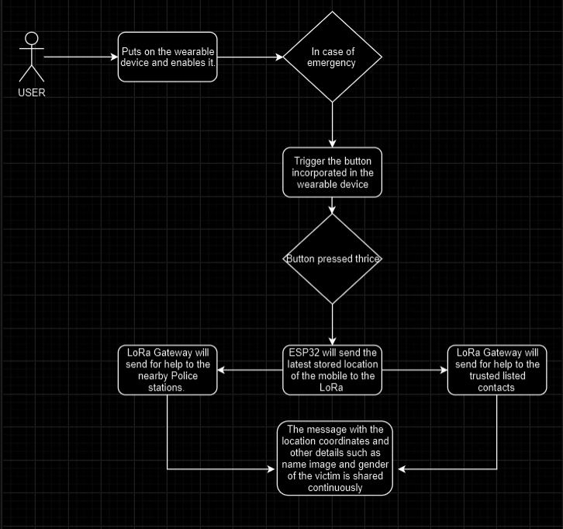
How it works ?

Slide 7
Advantages of LoRA
Long battery life for devices and sensors due to low power consumption
Low cost implementation due to low cost hardware and unlicensed spectrum
Long range coverage and in-building penetration
Offers a secure transmission network
Scalable network to support future upgrades
Ease of access and connectivity to the cloud applications
Remote management and control access
Highly intelligent architecture

Slide 8
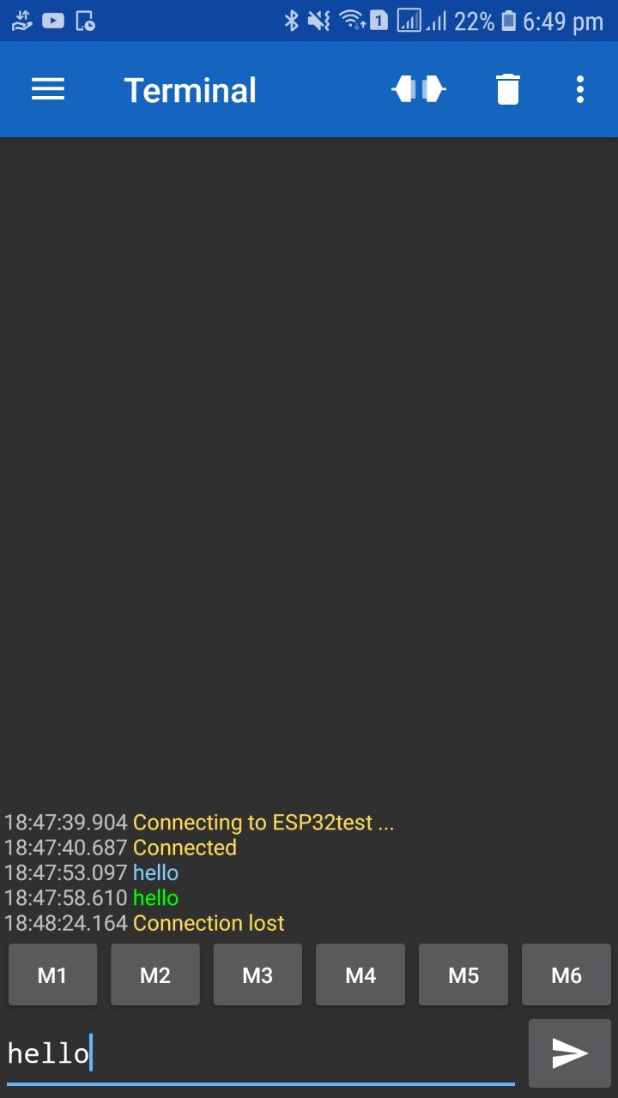
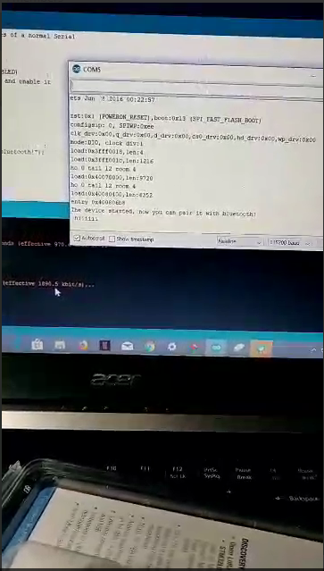
Screenshots

Slide 9


Future Scope
With the data collected when one contacts the police as well as the trusted individuals for help, the most targeted age - group and the most common offences against them can be identified.

Slide 10

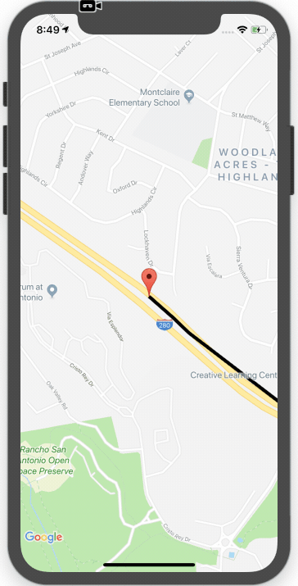

Which as a result will help to determine the areas that are most prone to such offences, and thus later can be integrated with maps to provide the users with the safest routes possible.

Slide 11
THANK YOU

